Slide 1

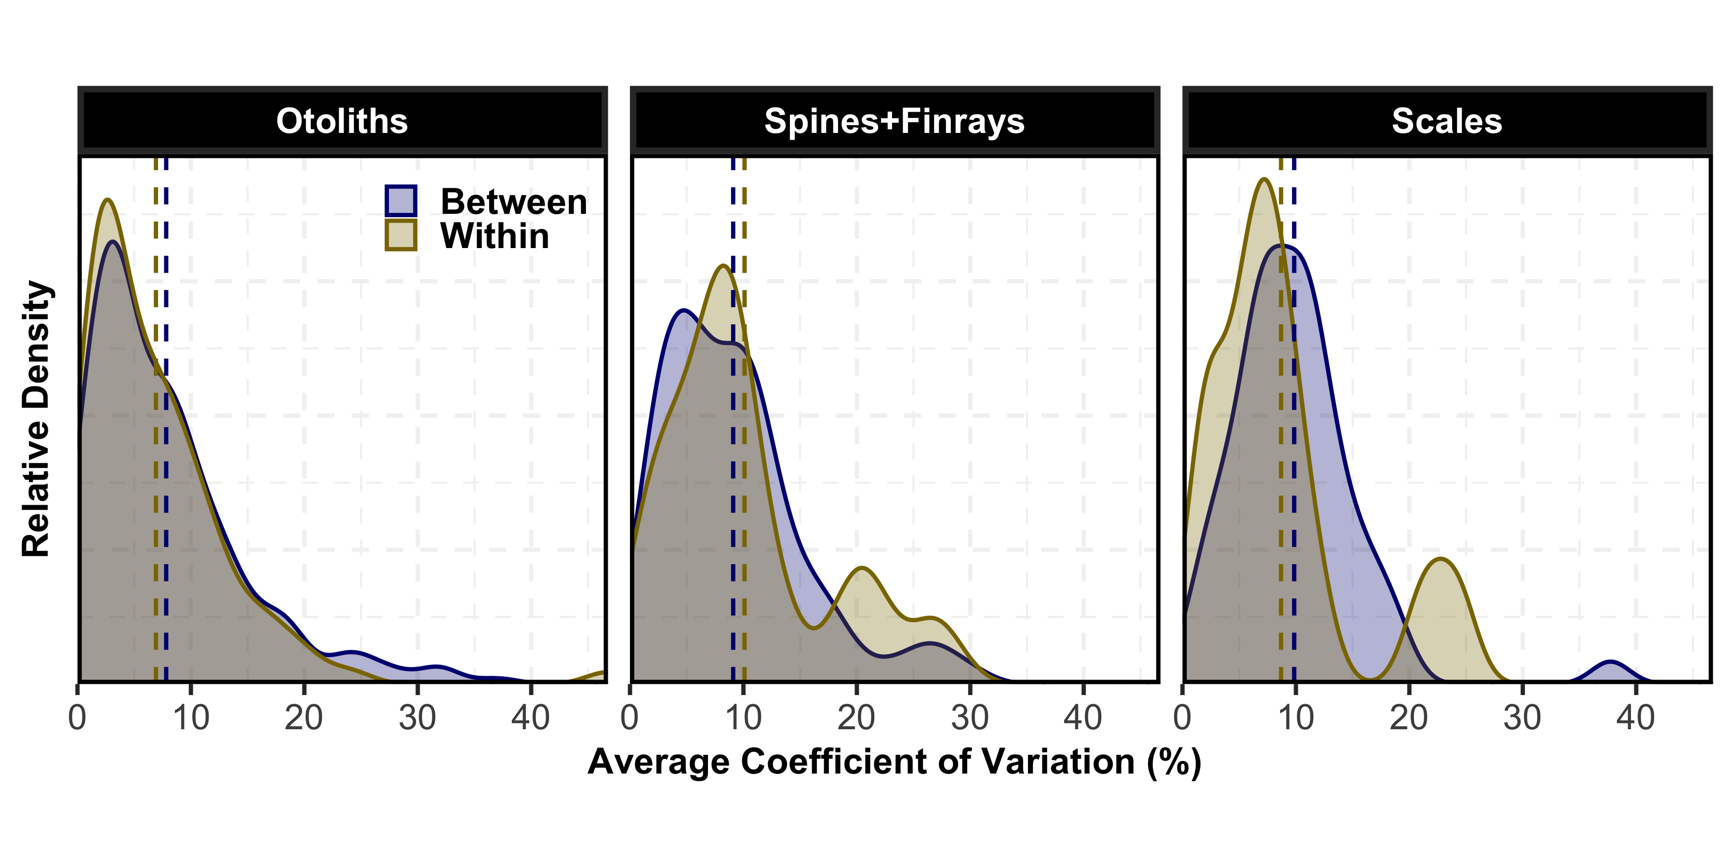
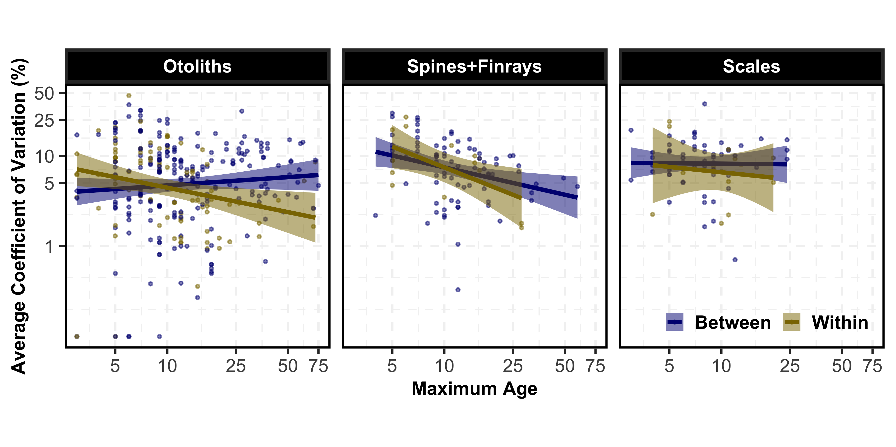
Estimating Fish Age: Influence of Maximum Age, Structure, and Comparison Type on Precision
Gordon S. Scott & Derek H. Ogle
Introduction
General Methods
Fish ages are crucial for understanding the population dynamics of fish stocks.
Fish ages are often estimated from calcified structures such as otoliths, spines, finrays, and scales.
Quality control is often assured using ages estimated by two people (between-reader) or twice by the same person (within-reader).
The average coefficient of variation (ACV) is the preferred metric (Campana, 2001; J. Fish. Biol) for estimating precision among multiple age estimates.
Our understanding of the distribution of ACV and variables that affect ACV is dated or lacking.
We examined 449 articles with 1447 separate measures of the precision of fish age estimates that were published in peer-reviewed journals from 1983 to 2021.
For each precision measure we recorded the calcified structure examined, type of comparison made (between- or within-reader), maximum estimated age, and ACV value.
The current analysis is restricted to precision measures where only two age estimates were made; a ray-finned fish was examined; and otoliths, scales, or spines and finrays (combined) were used.
Question 1: Does Mean ACV Differ by Structure or Comparison Type?
Question 2: Is ACV Related to Maximum Estimated Age?
Methods:
We used a two-way ANOVA to test the effects of calcified structure type (otoliths, spines+finrays, and scales) and comparison type (between- and within-reader) on the mean log-transformed ACV.
Tukey’s multiple comparison test was used to identify specific differences in group means.
Results:
Methods:
We used a two-way indicator variable regression (IVR) to determine how the relationship between log ACV and log maximum estimated age differed by calcified structure (otoliths, spines+finrays, and scales) and comparison (between- and within-reader) types.
One-way IVRs were used for between- and within-reader log ACV values separately to better understand the complex results of the two-way IVR.
Results:
Mean log ACV did not differ by the interaction between comparison and structure types (p=0.734) or by comparison type (p=0.406).
Mean log ACV did differ among the three structure types (p<0.001).
Mean log ACV was lower for otoliths than for spines+finrays (p=0.003) and scales (p=0.001), but spines+finrays and scales did not differ (p=0.755).
Mean ACV was 7.5% for otoliths, 9.3% for spines+finrays, and 9.6% for scales.
Discussion:
Precision was the same between two readers as between two estimates by the same reader.
Estimated ages were most precise for otoliths regardless of comparison type.
There is little evidence to support the thought that spines+finrays are more precise than scales.
The mean ACV for all structures is greater than the 5% threshold that Campana (2001; J. Fish. Biol) deemed precise for ray-finned fish.
The relationship between log between-reader ACV and log maximum age differed by structure type
(p=0.046), though the relationship only differed between otoliths and spines+finrays (p=0.036).
There was a negative relationship between log between-reader ACV and log maximum age for spines+finrays (p=0.037), with no relationship detected for otoliths (p=0.165) or scales (p=0.951).
The relationship between log within-reader ACV and log maximum age did not differ among the three structures (p=0.634).
There was a negative relationship between log within-reader ACV and log maximum age for all three structures (p=0.002).
Discussion:
The ACV is designed to be independent of estimated ages. Our results suggest that this is not the case for between-reader age estimates of spines+finrays and within-reader age estimates.
We hypothesize that the observed negative relationship between ACV and maximum age may be because estimating age is critical for long-lived species, so management agencies may use more resources to estimate precise ages for long-lived fish.

